Slide 1
Machine Learning

Slide 2
What is NumPy?
NumPy is a module for Python. The name is an acronym for "Numeric Python" or "Numerical Python".
It is pronounced /ˈnʌmpaɪ/ (NUM-py) or less often /ˈnʌmpi (NUM-pee)).
It is an extension module for Python, mostly written in C.
This makes sure that the precompiled mathematical and numerical functions and functionalities of Numpy guarantee great execution speed.

Slide 3
Operations using NumPy
Mathematical and logical operations on arrays.
Fourier transforms and routines for shape manipulation.
Operations related to linear algebra.
NumPy has in-built functions for linear algebra and random number generation.

Slide 4
How to install?
Standard Python distribution doesn't come bundled with NumPy module.
A lightweight alternative is to install NumPy using popular Python package installer, pip
pip install numpy

Slide 5
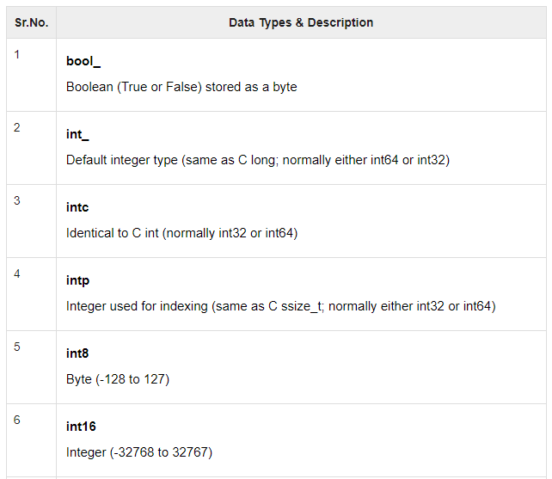
Data Types

Slide 6
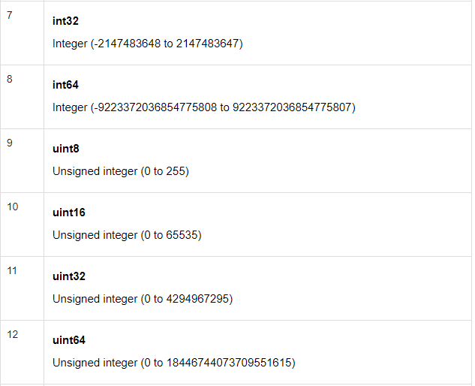
Cont..

Slide 7
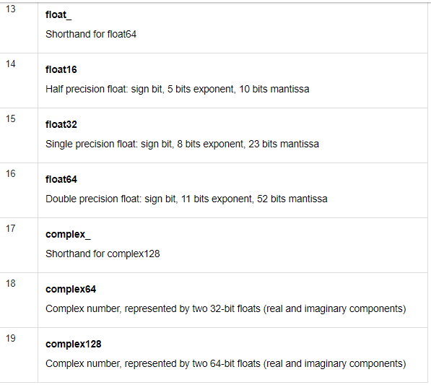
Cont..

Slide 8
Data Type Objects (dtype)
A data type object describes interpretation of fixed block of memory corresponding to an array, depending on the following aspects −
Type of data (integer, float or Python object)
Size of data
Byte order (little-endian or big-endian)
In case of structured type, the names of fields, data type of each field and part of the memory block taken by each field.
If data type is a subarray, its shape and data type

Slide 9
The ndarray data structure
NumPy adds a new data structure to Python – the ndarray
An N-dimensional array is a homogeneous collection of “items” indexed using N integers
Defined by:
the shape of the array, and
the kind of item the array is composed of

Slide 10
Array shape
ndarrays are rectangular
The shape of the array is a tuple of N integers (one for each dimension)

Slide 11
Array item types
Every ndarray is a homogeneous collection of exactly the same data-type
every item takes up the same size block of memory
each block of memory in the array is interpreted in exactly the same way

Slide 12
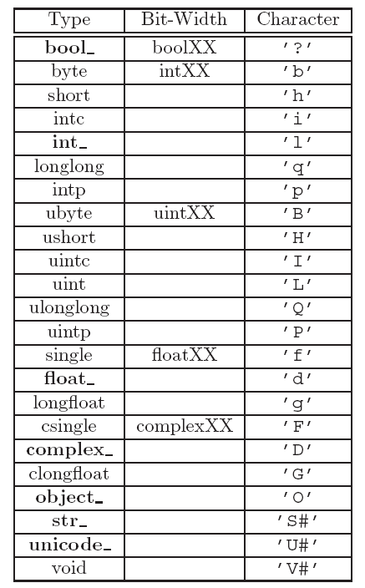

Slide 14
Example: creating an array
import numpy
a = array([[1,2,3],
[4,5,6],
[7,8,9]])
a.shape
a.dtype

Slide 15
Indexing arrays
Use a tuple to index multi-dimensional arrays
Example:
a[1,2]

Slide 16
Slicing arrays
Slicing arrays is almost the same as slicing lists, except you can specify multiple dimensions

Slide 17
Examples: Slicing arrays
a[1]
a[1,:]
a[1,1:]
a[:1,1:]

Slide 18
Some ndarray methods
ndarray. tolist ()
The contents of self as a nested list
ndarray. copy ()
Return a copy of the array
ndarray. fill (scalar)
Fill an array with the scalar value

Slide 19
Some NumPy functions
abs()
add()
binomial()
cumprod()
cumsum()
floor()
histogram()
min()
max()
multipy()
polyfit()
randint()
shuffle()
transpose()

Slide 20
Suggested exercise
Complete the desc_stat_calc.py program

